Slide 1
EMPLOYEE DATA ANALYSIS USING EXCEL
STUDENT NAME:YOGALAKSHMI M
NAAN MUDHALVAN ID:ASUNM1363422200527
REGISTER NO:422200527
DEPARTMENT:B.COM(ISM)
COLLEGE:VALLIAMMAL COLLEGE FOR WOMEN

Slide 2
PROJECT TITLE
MALE AND FEMALE EMPLOYEE COUNT ANALYSIS IN EACH DEPARTMENT

Slide 3
AGENDA
Problem Statement
Project Overview
End Users
Our Solution and Proposition
Dataset Description
Modelling Approach
Result and Discussion
Conclusion

Slide 4
PROBLEM STATEMENT
Analysis to measure the performance of male and female employees from a dataset using excel

Slide 5
PROJECT OVERVIEW
In this presentation we are going to see what are the features and techniques used in the excel to remove null values,error values,to create a summary and to visualize a data in a easy method.

Slide 6

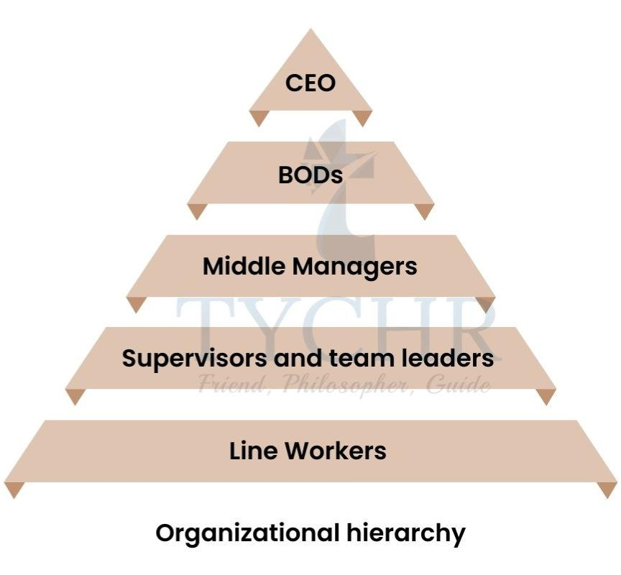
END USERS
Employee
Organisation
Firm
Industries
Small Sacle Business

Slide 7
OUR SOLUTION AND PROPOSITION
FILTERING:
The filtering feature is used to remove the missing values from the excel
CONDITIONAL FORMATTING:
Conditional formatting is used to highlight the blank values from excel
PIVOT TABLE:
Pivot table is used to view the summary of the whole excel data

Slide 8
OUR SOLUTION AND PROPOSITION
FORMULA:
=IFS(Z2>=5,”VERYHIGH”,Z2>=4,”HIGH”,Z2>=3,”MEDIUM”,TRUE,”LOW”)
RECOMMENDED CHARTS:
THE CHARTS ARE USED FOR FINAL REPORT FOR EASY VISULAIZATION

Slide 9
DATASET DESCRIPTION
EMPLOYEE DATASET –This dataset is taken from edunet dashboard
It has 26 features
From that I have taken 11 features
EMPLOYEE ID -Text Type Data
FIRST NAME -Text Type Data
LAST NAME -Text Type Data
BUSINESS UNIT -Text Type Data

Slide 10
DATASETDESCRIPTION
EMPLOYEE STATUS -Text Type Data
PAY ZONE -Text Type Data
DEPARTMENT TYPE -Text Type Data
GENDER CODE -Text Type Data
PERFORMANCE SCORE -Text Type Data
CURRENT EMPLOYEE RATING -Numeric Data
PERFORMANCE LEVEL -Text Type Data

Slide 11
THE “WOW” IN OUR SOLUTION
The wow solution is used in performance level to convert the numeric value of current employee rating into text data
FORMULA:
=IFS(Z2>=5,”VERYHIGH”,Z2>=4,”HIGH”,Z2>=3,”MEDIUM”,TRUE,”LOW”)

Slide 12
MODELLING APPROACH
DATA COLLECTION:
This dataset is collected from the naan mudhalvan edunet dashboard
FEATURES:
It has totally 26 features
From that I have taken 11 features
DATA CLEANING:
Conditional formatting is used to highlight balnk values
Filtering is used to filter missing and null values

Slide 13
MODELLING APPROACH
PERFORMANCE LEVEL:
VERY HIGH,HIGH,MEDIUM,LOW
PIVOT TABLE:
Business Unit
Performance Level
Gender Code
Pay Zone

Slide 14
RESULTS AND DISCUSSION

Slide 15
RESULTS AND DISCUSSION

Slide 16
CONCLUSION
Using excel features like conditional formatting,filtering,pivot table,charts I have removed null and blank values,highlighted cells,got the summary of the whole data and created a chart to visulazie the data in a simple and easiest way.
There are so many others features in excel,with excel we can make our big datas into easy visualization and it will make us understand the data easy.

Slide 17
THANK YOU

